Slide 1







Our Trusted Partners
Transform the process industry with AI-driven automation, empowering businesses in Chemicals, Energy & Materials.
The Next Level of Fire and Life Safety Leadership
Specialists in Control Panels, Switchgear and Power Distribution Solutions
Turning technology into “Technology for Life”
A global leader in precision flow-measurement and automation solutions.
Specializing in industrial safety automation and safety PLC solutions

Slide 2










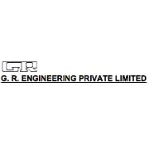
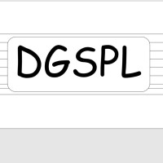


Our esteemed Clientele

